Slide 1
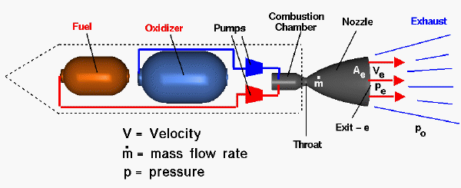
Rocket Physics The Rocket Nozzle
LabRat Scientific
© 2018

Slide 2
Relevant Concepts to Keep In Mind
SUBSONIC Gas Flow
Flow velocity is less than the speed of sound (< ~700 MPH)
As the area through which the gas is flowing decreases, the flow velocity increases and the pressure decreases
The convergent section of a nozzle increases the velocity of the subsonic flow
SONIC Gas Flow
Where the flow velocity is equal to the speed of sound (= ~700 MPH)
By design, this condition occurs at the throat (smallest cross-sectional area in the nozzle)
SUPERSONIC Gas Flow
Flow velocity is greater than the speed of sound (> ~700 MPH)
As the area through which the gas is flowing increases, the flow velocity increases and the pressure decreases
The divergent section (a.k.a. exit cone) of the nozzle increases the velocity of the supersonic flow

Slide 3
Thrust Equation
Thrust = ((Mass_{Propellant} * Velocity_{Exhaust}) / Time) + (P_{e} - P_{a}) * A
From this equation, we can see there are several ways to increase the thrust generated by a rocket motor:
1. Increase the total mass that is ejected from the motor
2. Burn the propellant faster (reduce the time period over which the motor burns)
3. Design a nozzle that maximizes the velocity of the gas that is ejected from the motor

Slide 4
Increasing the Mass Being Ejected from the Rocket Motor
The only way to increase the mass is to use a more dense propellant, or increase the amount of propellant.
Higher density propellant, or adding more propellant, causes the mass of the rocket motor to increase. While more mass will be ejected and thrust would increase, the rocket motor will be heavier, and F=ma says the rocket will not accelerate as much. Any gain in thrust will generally be offset by the reduction in final velocity due to the lower acceleration.
More fuel makes for a more complex motor, and certainly a more expensive one.
This is not the solution to maximizing the efficiency of a given rocket motor.

Slide 5
Burning Propellant Faster
We can dump more mass out the nozzle faster by burning the propellant quicker…
This sounds great, but we have a limited amount of propellant, so as the motor burns faster, the burn time will be shorter.
Faster burning propellant will increase acceleration, but since the motor will produce the acceleration over a shorter period, the final velocity will generally not be any higher.
Burning all the propellant at once is also know as an explosion! Not good for a rocket…
BOOM!
This is not the solution to maximizing the efficiency of a given rocket motor.

Slide 6
Increasing the Exhaust Exit Velocity
The only option left is to put a nozzle on the back of the motor to accelerate the exhaust gasses leaving the rocket motor.
To do this, we need to apply the earlier concepts of subsonic and supersonic gas flows (Slide 2), and design an efficient nozzle that perfectly expands the exhaust gas.
Let’s look at the elements of a rocket nozzle and see how it accelerates the exhaust gas.

Slide 7
Elements of the Rocket Nozzle
Convergent Section
Combustion Chamber
Divergent Section
Throat
Combustion
M=1
Combustion creates high pressure in the combustion chamber
A subsonic flow will increase in velocity as the area gets smaller
A supersonic flow will increase in velocity as the area gets greater
Gas wants to move from an area of high pressure to an area of low pressure, so a low velocity flow moves towards the nozzle.
A nozzle is designed so the flow is at Mach 1 in the throat. It can not be higher, but it can be less…

Slide 8
Elements of the Rocket Nozzle
Convergent Section
Combustion Chamber
Divergent Section
Throat
Combustion
M=1
So, the purpose of a nozzle is to accelerate the flow to its maximum possible velocity…

Slide 9
Elements of the Rocket Nozzle
Convergent Section
Combustion Chamber
Divergent Section
Throat
P_{e}
P_{a}
Combustion
M=1
This is achieved when the flow is perfectly expanded. A perfectly expanded flow is where the Exit Pressure (P_{e}) is equal to the Ambient Pressure (P_{a})

Slide 10
Elements of the Rocket Nozzle
Convergent Section
Combustion Chamber
Divergent Section
Throat
Combustion
M=1
Since the Ambient Pressure (P_{a}) is changing as we fly higher, and the nozzle geometry is fixed, maximum performance is only achieved at one point during the flight…

Slide 11
The Perfectly Expands Gas Flow
Thrust = ((Mass * Velocity) / Time) + (P_{e} - P_{a}) * A
As the exhaust gas moves through the nozzle, the gas pressure decreases. This allows the gas to accelerate (i.e. move faster).
If we make the Divergent Section (a.k.a Exit Cone) too short, the flow velocity will not have the opportunity of accelerate the maximum amount before it leaves the nozzle. This means the velocity at the exit plane is not maximized…
If we make the Divergent Section (a.k.a Exit Cone) too long, the flow velocity will be too high and the exhaust gas pressure will be less than the atmospheric pressure. This creates a vacuum at the nozzle exit plan. This vacuum tries to suck the motor backwards, reducing the effective thrust.

Slide 12
Let’s look at these concepts using a Pressure/Velocity Plot for the gas moving through a rocket motor…

Slide 13
Generic Pressure and Velocity in a Solid Rocket Motor
Combustion Chamber
Nozzle
Gas Pressure
We select the exit cone length such that the gas pressure is equal to the atmospheric pressure.
Gas Velocity
Represents a vacuum
The gas pressure decreases and the velocity increases as the gas moves through the motor

Slide 14
Generic Pressure and Velocity in a Solid Rocket Motor
Combustion Chamber
Exit Cone too short…
Nozzle
Gas Pressure
An exit cone that is too short results in an exit velocity that is not maximized…
Gas Velocity

Slide 15
Generic Pressure and Velocity in a Solid Rocket Motor
Combustion Chamber
Exit Cone too long…
Nozzle
Gas Pressure
An exit cone that is too long creates a vacuum at exit plane which has the effect of reduced thrust…
Gas Velocity

Slide 16
Generic Pressure and Velocity in a Solid Rocket Motor
Exit Cone just right…
Combustion Chamber
Nozzle
Gas Pressure
Ideal - Velocity maximized and no vacuum at the exit plane.
Gas Velocity

Slide 17
Theoretical calculations can be made and the results plotted to demonstrate where the maximum thrust exists…

Slide 18
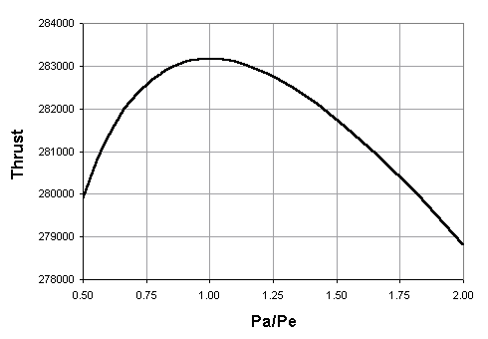
Maximum thrust occurs when P_{e} = P_{a} , and that condition will only happen at one specific altitude for a given nozzle configuration…
In this plot, we can see that the Thrust is maximized when Pa = Pe

Slide 19
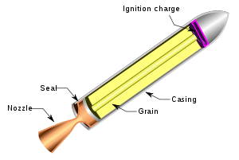
Questions?

